Slide 1
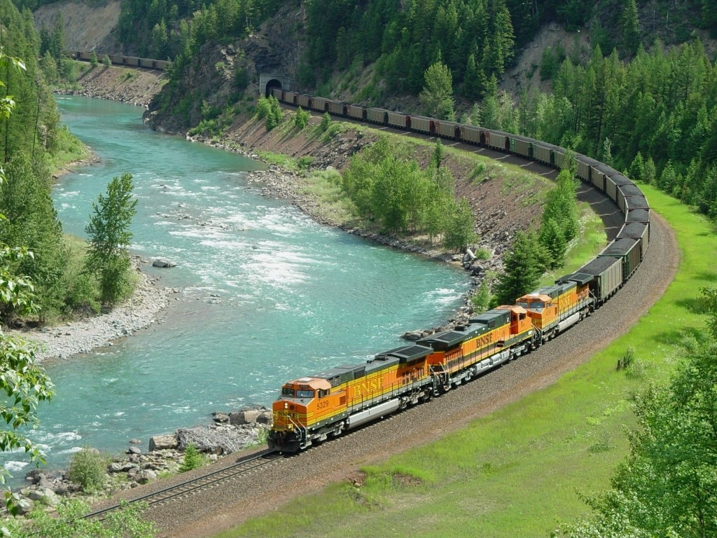
TRACK STRENGTH AND TRACK GEOMETRY DESIGN REQUIREMENTS
IF HEAVY FREIGHT TRAFFIC HAS TO COEXIST WITH
SEMI HIGH-SPEED PASSENGER TRAFFIC
IPWE SEMINAR
MUMBAI
2017
S. GOPALAKRISHNAN
RETD. AGM / S.Rly & RETD. DIRECTOR / IRICEN
EX. TECHNICAL ADVISER TRACK, GAMUDA ENGG, MALAYSIA

Slide 2
PREAMBLE
Under the combination of heavy freight traffic and
semi high-speed passenger traffic, track engineers’ concerns are:
Track deformation caused mainly by freight trains should not hinder passenger train requirements.
Track should remain maintainable with reasonable efforts and at affordable cost
Let us explore the theoretical aspects underlying
track deterioration or track fatigue,
which is required to be compensated by way of
track maintenance effort, followed by few other issues specifically chosen by the Author. Solutions will also be explored side by side.

Slide 3
Topic 1 - Track deterioration
AS A WHEEL RUNS ON TRACK, THE INSTANTANEOUS WHEEL LOAD Q VARIES WITH RESPECT TO ITS STATIC VALUE Q_{N}.
i.e., Q MAY BE GREATER THAN OR LESS THAN Q_{N}
INSTANTANEOUS WHEEL OVER-LOAD DECIDES THE TRACK DAMAGE.
(ALSO WEAR & TEAR OF VEHICLE COMPONENTS – CONCERN OF MECH. ENGRS)
THERE ARE TWO TYPES OF WHEEL OVERLOAD:
DYNAMIC OVERLOAD AND IMPACT OVERLOAD
DYNAMIC OVERLOAD IS INDUCED BY:
DEFECTS IN TRACK GEOMETRY
RESPONSE OF VEHICLE SUSPENSION & ITS MAINTENANCE STATE
DYNAMIC OVERLOAD PENETRATES DOWN TO VARIOUS LAYERS OF TRACK STRUCTURE. THIS IS CONSIDERED FOR DECIDING BENDING STRESSES IN RAIL, CONSEQUENT RAIL FATIGUE, SLEEPER-TO-BALLAST BEARING PRESSURE, AND FOMATION PRESSURE.
LEFT RAIL
RIGHT RAIL

Slide 4
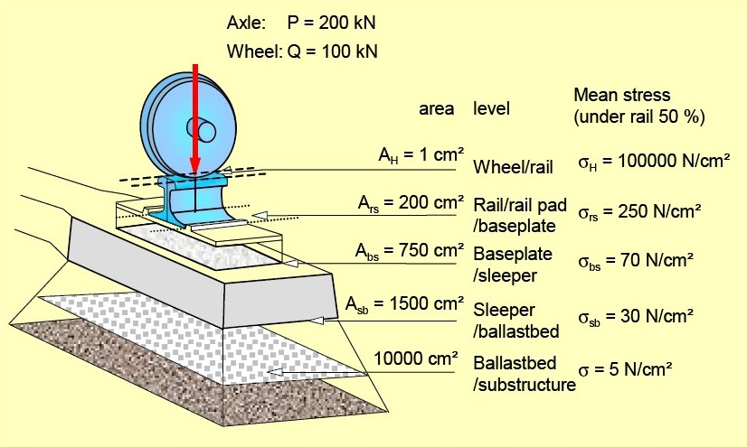
Topic 1 - Track deterioration - Continued
DISSIPATION OF DYNAMIC WHEEL OVERLOAD TO LOWER TIERS
Taken to include Dynamic Overload

Slide 5
Topic 1 - Track deterioration - Continued
IMPACT OVERLOAD IS INDUCED BY:
RAIL SURFACE DEFECTS (SCAB, WHEEL BURN, SPALL, RAIL CORRUGATION. DEFECTIVE WELD, etc.)
WHEEL SURFACE DEFECTS (FLAT, TYRE-SCAB, etc.)
EFFECT OF IMPACT OVERLOAD IS MOSTLY CONFINED TO
RAIL-WHEEL CONTACT. IT MAY EXTEND UP TO THE RAIL-PAD ON CONCRETE SLEEPER BUT STOPS THERE, IN A WELL DESIGNED TRACK.
IMPACT OVERLOAD IS CONSIDERED FOR DECIDING CONTACT STRESS & THE CONSEQUENT FATIGUE, PLASTIC FLOW OF RAIL METAL, FORCE STRIKING THE RAIL SEAT OF CONCRETE SLEEPER, WHICH IS MODERATED BY RAIL PAD.

Slide 6

Topic 1 - Track deterioration - Continued
COMING BACK TO DYNAMIC WHEEL OVERLOAD, THIS IS CONSEQUENT TO OSCILLATIONS OF NONSUSPENDED AND SUPENDED MASSES OF THE VEHICLE, INITIATED BY TRACK GEOMETRY VARIATIONS :
NON-SUSPENDED MASS
SUSPENDED MASS
SMALLER PROPORTION OF Q_{N}
BIGGER PROPORTION OF Q_{N}
VERY HIGH ACCELERATION
MUCH LOWER ACCELERATION
MAJOR COMPONENT OF DYNAMIC OVERLOAD
MINOR COMPONENT OF DYNAMIC OVERLOAD

Slide 7
Topic 1 - Track deterioration - Continued
APPLYING THE PRINCIPLES EXPLAINED IN THE PREVIOUS SLIDE,
DIFFERNET VEHICLES ARE COMPARED FOR THEIR SPEED POTENTIAL AS FOLLOWS. TRACK DETERIORATION CAUSED BY DYNAMIC OVERLOAD HAPPENS TO BE THE INVISIBLE UNDERLYING FACTOR, WHICH IS NOTHING BUT MANIFESTATION OF THE LAW OF NATURE.
EMU : LIGHTER AXLE LOAD P - MEDIUM NON-SUSPENDED MASS - SUPERIOR SUSPENSION UNDER GOOD MAINTENANCE
HENCE, HIGH SPEED IS PERMITTED
LOCO: HEAVY AXLE LOAD P - HEAVY NON-SUSPENDED MASS - GOOD SUSPENSION UNDER GOOD MAINTENANCE
HENCE, MEDIUM SPEED IS PERMITTED
WAGON: HEAVY AXLE LOAD P - LESSER NON-SUSPENDED MASS
- SIMPLIFIED DESIGN OF SUSPENSION UNDER AVERAGE MAINTENANCE
HENCE, LOW SPEED IS PERMITTED
PASSENGER COACH (LOCO HAULED) PERFORMS CLOSE TO EMU.

Slide 8
Topic 1 - Track deterioration - Continued
Dr. A. PRUD’HOMME’S INVESTIGATION:
TRACK FATIGUE IS PROPORTIONAL TO Q³_{N}(1+3σ²)
Q_{N} IS THE STATIC WHEEL LOAD
σ IS RELATIVE STANDARD DEVIATION = Q_{A}/2Q_{N} WHERE Q_{A} IS THE MAXIMUM DYNAMIC WHEEL OVERLOAD.
σ DEPENDS ON TRACK GEOMETRY, SPEED, SUSPENSION CHARACTERISTICS, PROPORTIONS OF SUSPENDED & NON-SUSPENDED MASSES.
PRUD’HOMME CALCULATED RELATIVE TRACK FATIGUE FACTORS TFF [= Q³_{N}(1+3σ²)] FOR WHEEL LOADS OF DIFFERENT VEHICLES AT VARIOUS SPEEDS, AS FOLLOWS:
EMU: P = 16 t : V = 300 km/h -> TFF = 710
LOCO: P = 20.6 t : V = 200 km/h -> TFF = 1375
WAGON: P = 20 t : V = 70 km/h -> TFF = 1120
THESE TFF VALUES ARE AS DECIDED FOR A PARTICULAR TRACK STRETCH ON SNCF (STANDARD GAUGE), WITH VEHICLES OF THE EARLIER DESIGN.

Slide 9
Topic 1 - Track deterioration - Continued
The ORE Committee (D-161) have also concluded in 1988 (much later to Prud’Homme’s findings) that
Rail fatigue, fatigue of other components and track geometry deterioration varies as the 3rd power of wheel load
Rail surface defect varies as power 3.5 of wheel load.
Therefore, Prud’Homme’s findings related to track deterioration continues to be valid for the current design situations too.
THE PRINCIPLE TO BE BORNE IN MIND:
TRACK DETERIORATION VARIES PROPORTIONAL TO Q_{N}³
WHEN TRACK ENGINEERS HEAR PROPOSALS FOR INTRODUCING 30t OR 35t AXLE LOADS, THEY SHOULD INTROSPECT AS TO WHETHER TRACK WILL BE STRENGTHENED ACCORDINGLY.
INCREASE OF AXLE LOAD 20t TO 35t MEANS:
TRACK DETERIORATES 5.36 TIMES FASTER.

Slide 10
Topic 1 - Track deterioration - Continued
Remedies for the harmful effects of Dynamic Over-loading:
Improved rails (This will be dealt in more detail under “Impact Over-loading”)
Modern fasteners in par with advanced railways
Concrete sleepers designed according to EN or UIC specifications
Maintaining track geometry, as diagnosed by Track Recording Car, in lieu of manual examination by trolley. Self Propelled TRCs to be provided for each zonal railway
Of course, all measures to improve all parts of track structure, viz., Ballast, Sub-ballast, Formation treatment, Ensuring reliable drainage.

Slide 11
Topic 1 - Track deterioration - Continued
CURRENTLY WIDELY USED FASTENERS

Slide 12
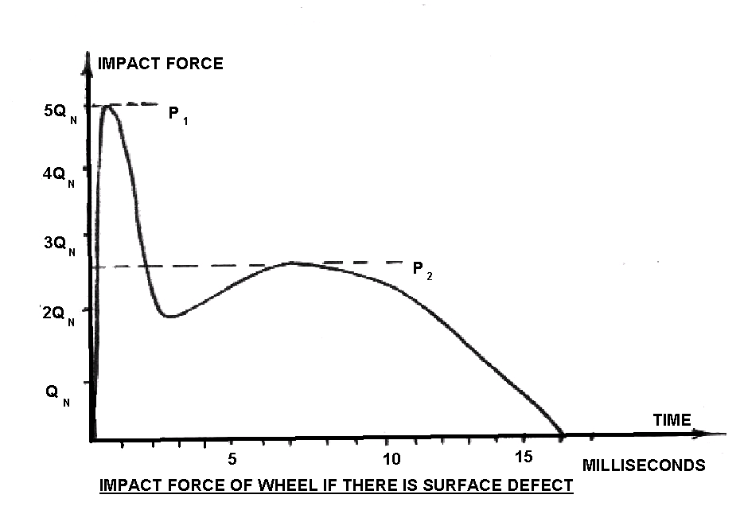
Topic 1 - Track deterioration - Continued
Rail surface defect
IMPACT WHEEL OVER-LOAD
Wheel flat
hits here
  Within 1 millisecond of start of impact, a force P₁ (= 4-6 times Q_{N}) hits the rail. This impact reduces, but again attains second peak P₂ (= 2-3 times Q_{N}) at the end of 6-8 milliseconds. P₁ force decides the maximum contact stress between wheel & rail. P₁ increases with the speed of wheel, whereas P₂ is not much influenced by speed. Amplification Factors F_{a1} and F_{a2}, that is, (P₁/Q_{N}) and (P₂/Q_{N}) depend on the severity of rail defect or wheel flat.

Slide 13
Topic 1 - Track deterioration - Continued
MAXIMUM SHEAR STRESS IN RAIL AT 4-6 mm BELOW RAIL-TOP:
Ψ = 412 √ (P₁/r) WHERE r IS WHEEL RADIUS
P₁ IS INSTANTANEOUSLY INCIDENT LOAD
Ψ SHOULD NOT EXCEED 38% OF UTS OF RAIL ξ, i.e., Ψ ≤ 0.38 ξ
THESE EQUATIONS LEAD TO THE CONCLUSION:
WE MAY ALLOW MAX. VALUE OF P₁ = [8.507.10⁻⁷.r.ξ²] FROM THE CONSIDERATION OF MAXIMUM PERMISSIBLE SHEAR STRESS.
FROM PERMISSIBLE P₁ MAX. AXLE LOAD IS COMPUTED AS BELOW:
AMPLIFICATION FACTOR F_{a1} = P₁/Q

Slide 14
Topic 1 - Track deterioration - Continued
The Table in previous slide indicates that IR should go in for rail-steel with UTS 1175 Mpa. All advanced railways, under similar service conditions, have adopted Rail Steel of Grade R350HT or R350LHT as per EN 13674-1.
These Grade Rails are fully Heat Treated. ‘Head Hardening’ of UTS900 steel is not the right solution, because Head Hardening Process has become obsolete, consequent to the investigation into the derailment near Hatfield in UK on 17.10.2000 killing 4 passengers. There in no international specification to cover head hardening. The Author has seen two abandoned head hardening plants in China.
Incidentally, China has become pioneer in manufacturing rails to EN 13674-1.

Slide 15
Topic 1 - Track deterioration - Continued
Solutions to resolve Impact Over-loading:
Use of rails of EN Gr. R350HT / R350LHT (UTS 1175 MPa).
Welding of rails to superior quality, complying EN-14587-1 for FB Welding and EN-14730-1 for AT welding.
Use of rail pads of requisite elasticity (EVA, HDPE, Rubber) depending on the relative mix of freight & passenger loads, so that the effect of Impact Overload stops with rail pad.
Rail Grinding Machine should be deployed periodically to eliminate surface defects on rail head and gauge face.
Dimensions of permissible Wheel flats should be restricted than at present. Wheel tyre profiles should be maintained to strict tolerances. Specifically, false flange occurrence should not be allowed, since it causes continuous spalling of metal on rail head, ultimately leading to fatigue failure.

Slide 17
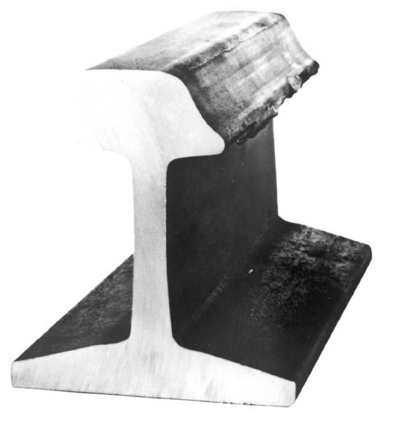
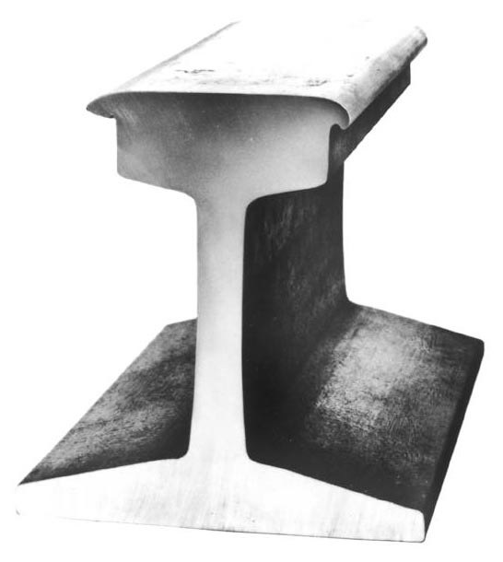
Topic 2 – Design of horizontal curve for mixed traffic
IRPWM stipulations to determine Cant, Cant Deficiency, Cant Excess and Transition curve length (based on 3 criteria) are entirely applicable to mixed traffic lines.
However, the stipulation in Para 406(b) is not specific for deciding the Equilibrium Speed to calculate actual cant to be provided. Chief Engineer’s intervention is required to decide the most probable speeds of freight & passenger trains in each sub-section. But this procedure is seldom followed. Designers assume 75% of passenger train’s speed as Equilibrium Speed, as mentioned in simplified lecture notes.
Lower Equilibrium Speed assumed. Outer rail wears out.
Higher Equilibrium Speed assumed. Inner rail gets flattened.

Slide 18
Topic 2 – Design of horizontal curve for mixed traffic - continued
The following UIC guidelines may be advantageously adopted:
Cant C = GV²/127R = [G/127] x [V²/R] .
Here, [V²/R] represents the centrifugal force.
Suppose N number of trains are running, each at its own (but different) speed, then ∑[V²/R] / N will give the average centrifugal force.
For a given curve, factor [G/127R] is constant. Hence the average of V² needs to be computed for applying in the cant formula.
Suppose N₁ trains travel at speed V₁, N₂ trains at speed V₂, ……etc.,
Weighted average of V² = (N₁V₁²+N₂V₂²+N₃V₃²+) / (N₁+N₂+N₃+… )
This will therefore be V_{E}², where V_{E} represents equilibrium speed.
This principle of computing V_{E}² may be further refined, by considering the weights of various trains, since rail damage caused by each train is proportional to its gross weight.
So, V_{E}² = {W₁N₁V₁²+W₂N₂V₂²+W₃N₃V₃²+..} / {W₁N₁+W₂N₂+W₃N₃+…}
(Instead of actual weights of trains, proportional weights may be substituted in this formula.)

Slide 19
Topic 2 – Design of horizontal curve for mixed traffic - continued
The procedure given in previous slide is quite logical to be followed in mixed traffic regime. Life span of rails is increased and derailment possibility is minimized.
This procedure may be applied in conjunction with the Para 406(b) of IRPWM. It will be necessary to divide the section into appropriate sub-sections to decide V_{E}. In sections of continuous long gradient, UP and DOWN sections should be treated as sub-sections for applying these formulae. Computer Simulation of Train Operation can be advantageously used to get the values of V₁, V₂, etc.
For mixed train operation, it is important to limit Cant Excess as 75mm, vide Para 406(3). After deciding V_{E} , Cant Excess is calculated as:
Cant corresponding to V_{E} – Cant corresponding to the actual speed of freight train in the curve under consideration.
(This is a refinement to the present stipulation in IRPWM.)

Slide 20
Topic 3: Issues of high c.g. in double stack container wagons
For normal BG freight stock, the overall size of Maximum Moving Dimension is (B)3300mm x (H)4265mm. Height of CG above rail level is nearly 1800mm.
For the Western Dedicated Freight Corridor, designed for double stack container traffic, the size of Maximum Moving Dimension is 3660mm x 7100mm. For the Eastern Freight Corridor, the same is 3660mm x 5100mm. The height of CG above rail level for Double Stack Container is 2600mm.
It would be purposeful to analyse the effects of running Double Stack Container (DSC) wagons with very high CG.
Here are some calculations, in line with (erstwhile) Japanese National Railways (JNR) practice, to compare the stability of DSC Stock with that of normal BG stock.

Slide 21
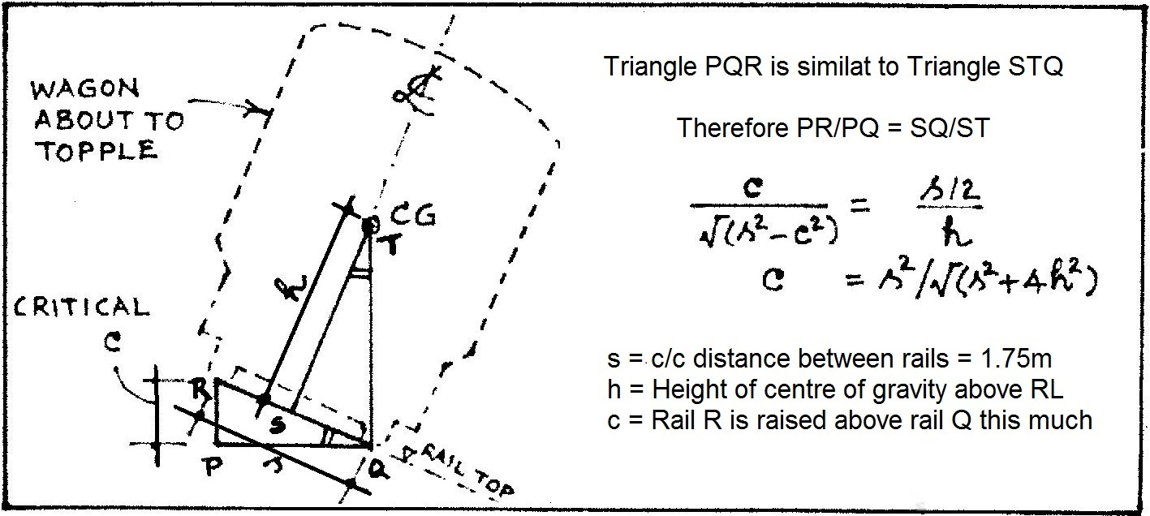
Topic 3: Issues of high c.g. in double stack container wagons – contd.
For Normal BG stock (h = 1.8m), critical value of c = 0.765m
For double stack wagon (h = 2.6m), critical value of c = 0.558m
JNR had prescribed, Maximum cant in a curve ≤ c/3.
i.e. Factor of safety = 3. This is to avoid toppling of a slow vehicle, considering unfavourable wind / earthquake force, lateral sliding of merchandise carried, abrupt coupling forces, etc.

Slide 22
Topic 3: Issues of high c.g. in double stack container wagons – contd.
Hence, max. permissible cant (c/3) can be 255 mm for normal BG stock and 186 mm for DSC wagon. As per IRPWM Cant ≤ 165mm. OK.
However, the following precautions apply in the case of DSC wagon:
The merchandise carried should be tied/held to prevent sliding.
Loaded container should not be stacked above empty container.
That is not all. On-loading and Off-loading of wheels (namely as Q+∆Q and Q-∆Q) will be more pronounced in the case of DSC wagon, compared to normal wagon, as explained here.
If F is the lurch-force acting horizontally at CG, then ∆Q = Fh/s. i.e., for the same lurch-force, ∆Q will be proportional to h. i.e., ∆Q in the case of DS wagon will be 1.44 times (=2.6/1.8) that of normal wagon.
Track engineers should know that variation of vertical forces on track will be 44% more in the case of DSC wagons than that for normal BG wagon. This will increase the track loading on one hand and increase derailment possibility due to off-loading on the other hand.

Slide 23
Topic 4: minimum distance to be provided between adjacent grade-change points
This issue came up in Western Dedicated Freight Corridor Project, meant for Double Stack Containers Traffic. The Design Consultant suggested that a minimum distance of 750m (one freight train length) may be provided between adjacent grade-change points, as a good practice. This will ensure that the train will not travel over more than two grades at any instance, so that the travel is jerk-free and the coupling forces do not fluctuate violently within the train length.
This argument is likely to be extended to other freight line projects not meant to carry double stack container traffic. Unfortunately, IRPWM does not have any stipulation for this.
The analysis herein addresses this issue. Also, it provides rationale for appropriate stipulation to be included in IRPWM.

Slide 24
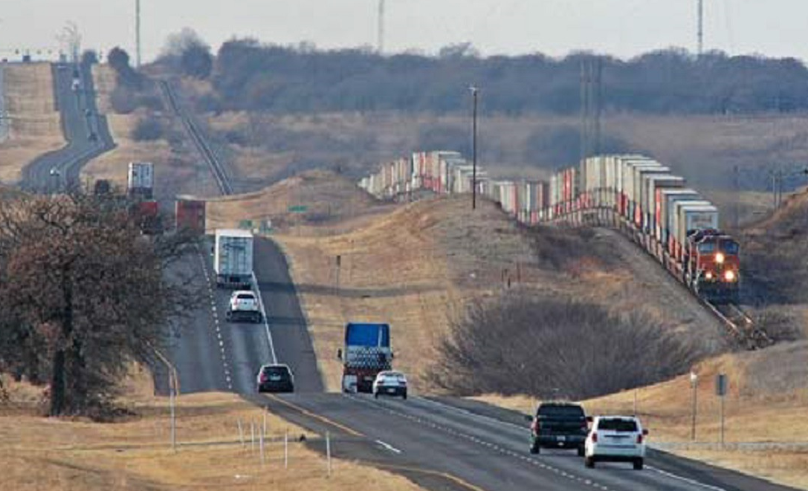
Topic 4: minimum distance between adjacent grade-change points – Contd.
Double stack container trains are operated in USA, Australia and China. This photo from USA provides evidence that a long freight train can safely travel over multiple gradients within its length.
Let us examine what stipulations of AREMA have made this possible.

Slide 25
Topic 4: minimum distance between adjacent grade-change points – Contd.
Chapter 6 of ‘Railway Track Design’ by AREMA does not directly specify the minimum distance between grade-change points; but it gives rational stipulation for vertical curve separately for passenger and freight lines, from which this minimum distance can be derived.
Assume, a train passes over a ‘crest profile’ where +1:100 grade is followed by -1:100 grade, with a vertical curve of radius R (m). Speed = v (m/sec). A passenger in the train will undergo a vertical acceleration of v²/R (m/sec²) in upward direction, i.e., a weight loss of (W/g).v²/R.
If the train passes over a similar ‘valley profile’, he will experience a weight addition of (W/g).v²/R. Reduction or addition of weight causes passenger discomfort. For freight train, this situation may lead to vertical forces acting at couplers, sometimes leading to train parting.

Slide 26
Topic 4: minimum distance between adjacent grade-change points – Contd.
European Railways prescribes:
Max. vertical acceleration (for passenger trains) 2% of g
= 0.1962 m/sec² (0.64 ft/sec²). Exceptionally, 0.06g on SNCF.
AREMA prescribes:
0.6 ft/sec² (1.86% of g) for passenger trains
0.1 ft/sec² for freight trains.
AREMA explains that the reasons for prescribing lesser value for freight operation are (i) Limitation of coupler performance
(ii) Ensuring smooth travel (iii) Need to reduce off-loading of wheel load, eliminating derailment possibility.
Hence, IR may adopt the limiting value as 0.0305 m/sec² (i.e., 0.1 ft/sec²) for freight lines. Freight train derailing at valley location due to bunching of wagons is not uncommon on IR. So, a large radius for vertical curve is justified.

Slide 27
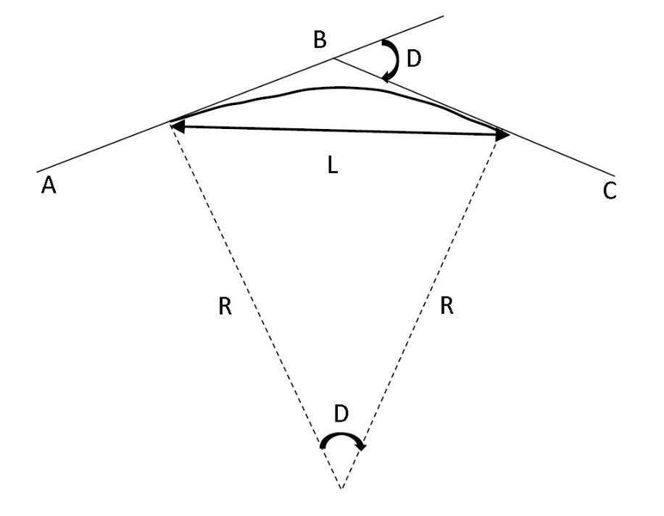
Topic 4: minimum distance between adjacent grade-change points – Contd.
IRPWM stipulates Radius of vertical curve as follows:
Route Classification | R
Group A | 4000m
Group B | 3000m
Groups C, D & E | 2500m
AREMA formulae for radius R of vertical curve and its length L, when converted to metric units:
R = L/D
L = 0.07716 V²D / A
Where D = algebraic difference
of grade in decimal,
V = train speed in km/h,
A = vertical acceleration
= 0.0305 m/sec² for freight,
= 0.183 m/sec² for passenger

Slide 28
Topic 4: minimum distance between adjacent grade-change points – Contd.
Example of a freight line with Design Speed 100km/h:
Crest Profile: Grade of +0.5% followed by -0.5% (ruling grade).
D = 0.005 - (-0.005) = 0.01; A=0.0305 m/sec²
L = 0.07716 x 100² x 0.01 / 0.0305 = 253 m. Rounded as 250m.
R =L/D=250/0.01= 25000 m (Far greater than 2500-4000m prescribed in IRPWM)
Calculation of Min. Distance between adjacent grade-change points:
If no straight between vertical curves is provided, distance d will be L/2+L/2=L= 250m. It is desirable to provide a straight length s between the tangent points, equal to 2 second travel length, which will enable stabilizing of wagon oscillations as it enters from rising to falling grade. Straight length s = 2x(100/3.6) = 55.5m ≈ 60m. Distance between crest and valley = 250+60 = 310m.

Slide 29
Topic 4: minimum distance between adjacent grade-change points – Contd.
If R=3000m is adopted as per IRPWM, distance d would be (0.01x3000) + 60 = 90m.
If one train length is adopted, d would be 750m
AREMA’s rational approach has yielded d = 310m, which is cost-optimised, ensuring safety and smooth travel of train.
In case d = 310m can not be provided due to site constraint or cost consideration, distance d can be calculated, in site-specific manner, considering the actual values of gradients.
SUMMARY: Radius of vertical curve should not be prescribed arbitrarily; but should be based on limiting the vertical acceleration, appropriate for passenger or freight traffic. Minimum distance between adjacent grade-change points should also be decided, following the above principle, on site-specific basis, considering the speed and the gradients of vertical profile. IRPWM needs amendment for this.

Slide 30
CONCLUSION
It is not possible to summarise the recommendations or the findings with serial numbers. This Paper has hovered over multiple topics, packing technical information in each Topic. The objective is to seed interest in the minds of track engineers enabling a clear understanding. Also, opportunity has been availed to bring to the kind attention of this Forum and Decision Makers that a wide gap has been allowed to grow between IR and other advanced railways of the world. It is necessary to continuously watch for the advancements abroad and to straightaway implement the good practices instead of inventing wheel every time. The Author will feel contended, if the thought process initiated in this Paper is taken forward positively to alleviate the challenges faced by the field engineers in maintaining track carrying heavy freight traffic along with semi-high speed passenger traffic.
(Contact for any clarification: sgkdorai@yahoo.com)

